Slide 1


Scientific Machine Learning
Lecture 7: PINN for Inverse Problems
孟旭辉
数学与统计学院数学与应用学科交叉创新研究院
办公室：欣苑2栋111室
Email：xuhui_meng@hust.edu.cn
https://github.com/XuhuiM/SciML-Course
3/15/2023

Slide 2
Contents
On spectral bias of neural networks
PINN for inverse problems

Slide 3
Contents
On spectral bias of neural networks
PINN for inverse problems

Slide 4


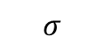
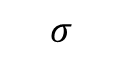
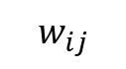

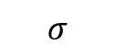
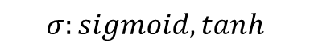
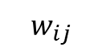
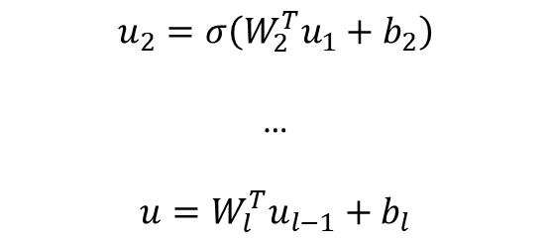

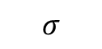
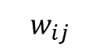

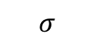
From DNNs to PINNs
$$w_{ij}$$
$$w_{ij}$$
$$σ$$
$$σ$$
$$u_{1}=σ(W_{1}^{T}x+b_{1})$$
$$w_{ij}$$
$$σ$$
$$σ$$
$$u_{2}=σ\left(W_{2}^{T}u_{1}+b_{2}\right)$$
…
$$u=W_{l}^{T}u_{l−1}+b_{l}$$
u
$$σ$$
$$σ$$
$$σ$$
$$σ$$
$$σ:sigmoid, tanh$$
Loss in physical space: $L={∫\left[u\left(x\right)−u^{∗}\left(x\right)\right]}^{2}dx$
Parseval’s theorem
Loss in frequency space: $L={∫\left[\tilde{u}(k) −\tilde{u^{∗}}\left(k\right)\right]}^{2}dk$

Slide 5
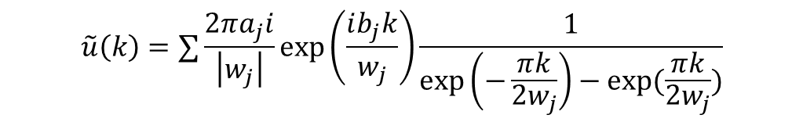
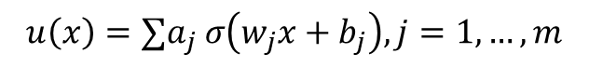
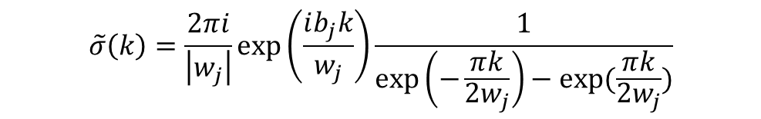
Loss in frequency space
Consider a NN with one hidden layer
Activation function: tanh
Output of DNN:
$$u\left(x\right)=∑a_{j} σ\left(w_{j}x+b_{j}\right), j=1,…,m$$
$$\tilde{σ}\left(k\right)=\frac{2πi}{\left|w_{j}\right|}\exp\left(\frac{ib_{j}k}{w_{j}}\right)\frac{1}{\exp\left(−\frac{πk}{2w_{j}}\right)−exp⁡(\frac{πk}{2w_{j}})}$$
$$\tilde{u}\left(k\right)=∑\frac{2πa_{j}i}{\left|w_{j}\right|}\exp\left(\frac{ib_{j}k}{w_{j}}\right)\frac{1}{\exp\left(−\frac{πk}{2w_{j}}\right)−exp⁡(\frac{πk}{2w_{j}})}$$
Xu, et al. arxiv, 2022

Slide 6
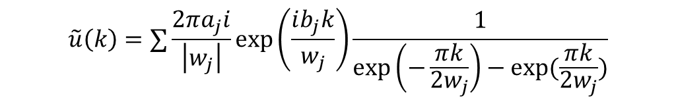
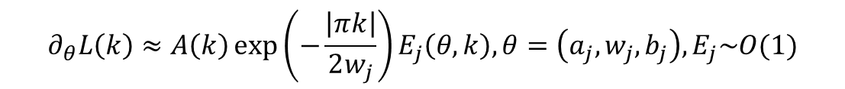
Loss in frequency space
Consider a NN with one hidden layer
Activation function: tanh
$$\tilde{u}\left(k\right)=∑\frac{2πa_{j}i}{\left|w_{j}\right|}\exp\left(\frac{ib_{j}k}{w_{j}}\right)\frac{1}{\exp\left(−\frac{πk}{2w_{j}}\right)−exp⁡(\frac{πk}{2w_{j}})}$$
$$δ\left(k\right)=\tilde{u}\left(k\right)−{\tilde{u}}^{∗}(k)$$
$$L\left(k\right)={\left|\tilde{u}\left(k\right)−{\tilde{u}}^{∗}\left(k\right)\right|}^{2}, L=∫L\left(k\right)dk$$
$$∂_{θ}L\left(k\right)≈A\left(k\right)\exp\left(−\frac{\left|πk\right|}{2w_{j}}\right)E_{j}\left(θ,k\right),θ=\left(a_{j},w_{j},b_{j}\right), E_{j}\sim O(1)$$
Xu, et al. arxiv, 2022

Slide 7

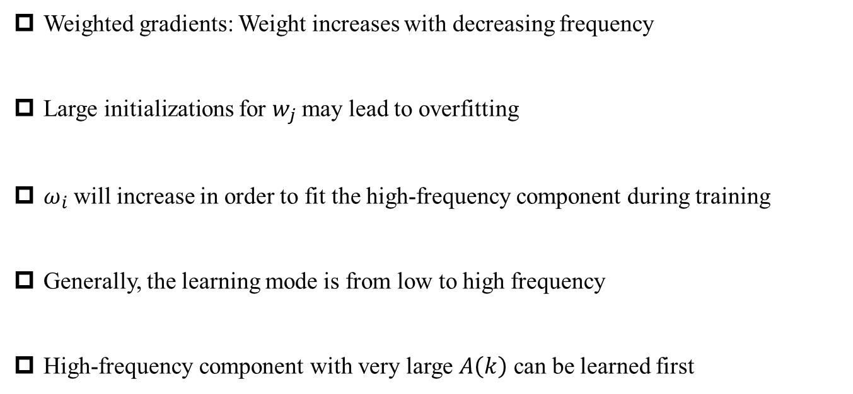
Loss in frequency space
$$∂_{θ}L\left(k\right)≈A\left(k\right)\exp\left(−\frac{\left|πk\right|}{2w_{j}}\right)E_{j}\left(θ,k\right)$$
Weighted gradients: Weight increases with decreasing frequency
Large initializations for $w_{j}$ may lead to overfitting
$ω_{i}$ will increase in order to fit the high-frequency component during training
Generally, the learning mode is from low to high frequency
High-frequency component with very large $A\left(k\right)$ can be learned first
Xu, et al. arxiv, 2022

Slide 8
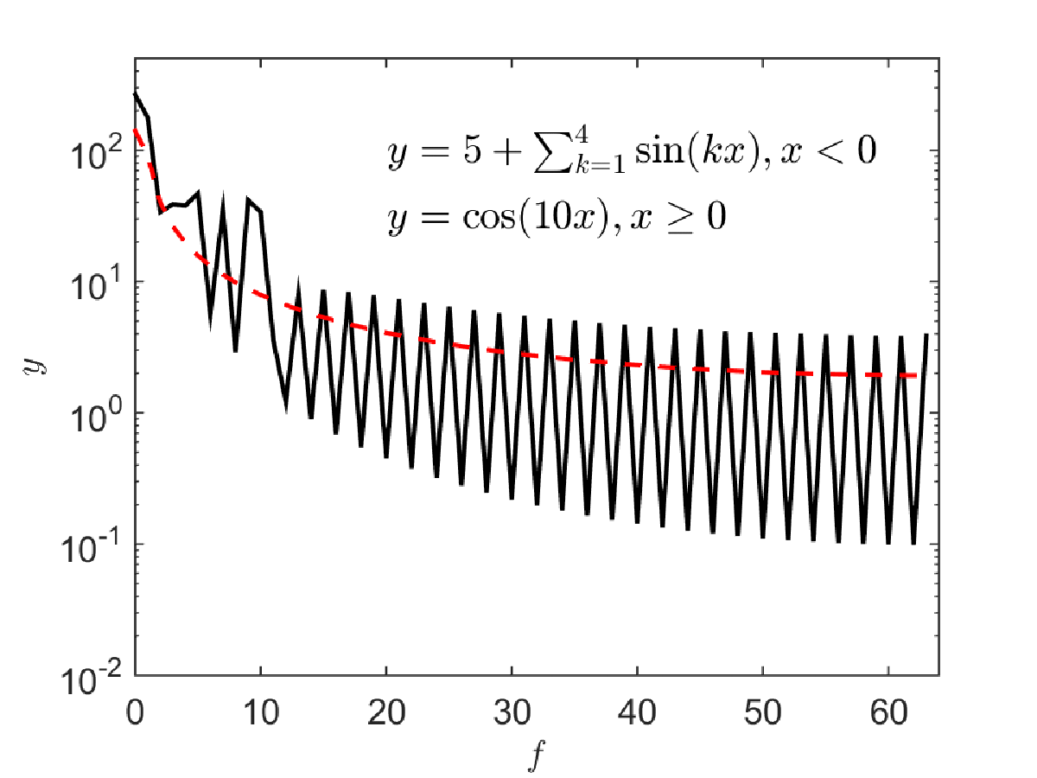
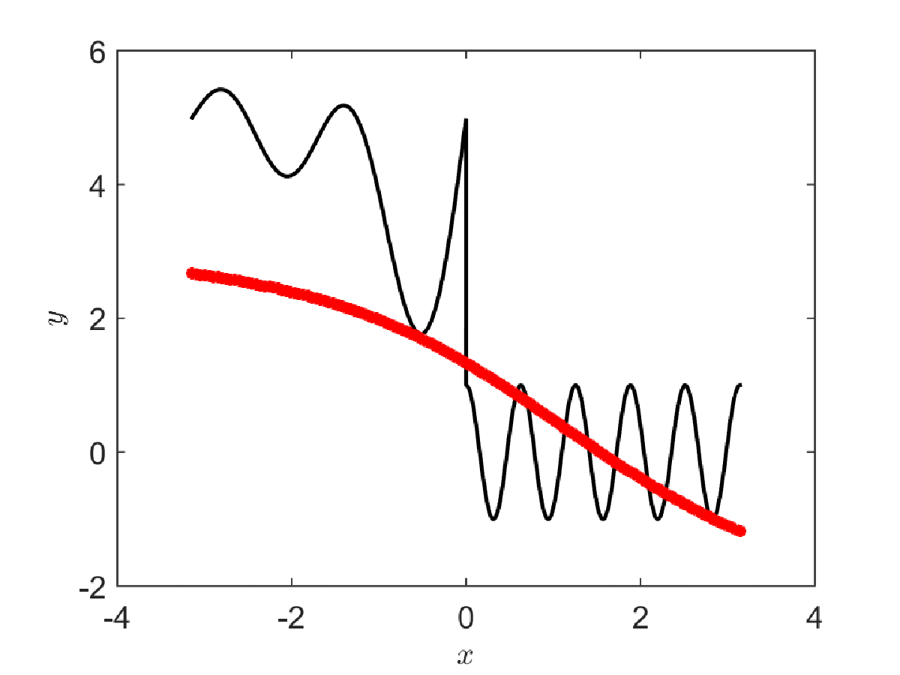


Numerical experiment I
$$w\sim N\left(0, 0.1\right)$$
$$NN\sim 2×20$$

Slide 9
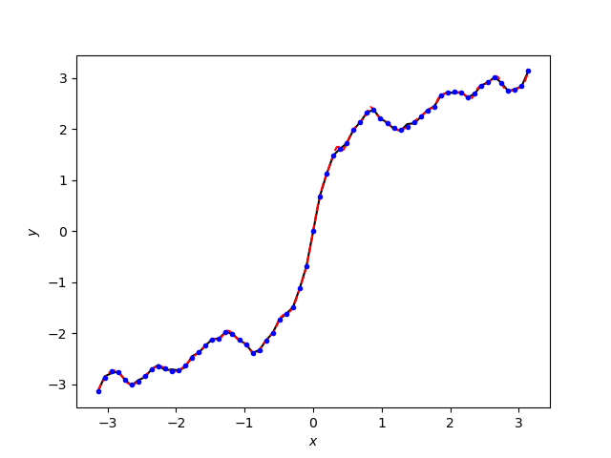
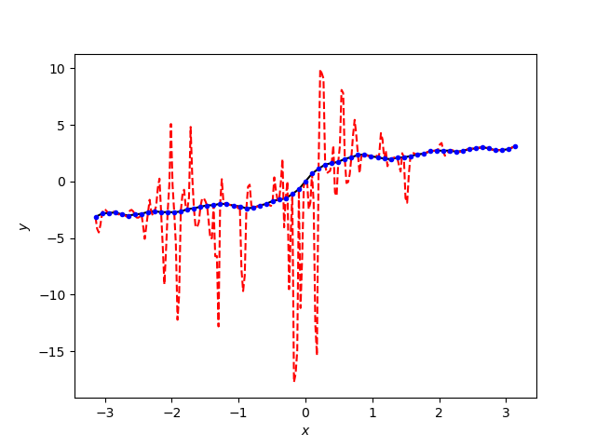


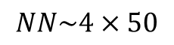
Numerical experiment II
$$NN\sim 4×50$$
Red: DNN
Blue: training data
Black: Ref
$$w\sim N\left(0, 0.1\right)$$
$$w\sim N\left(0, 2\right)$$
$$Regularization:L=λ{\left|w\right|}^{2}$$

Slide 10
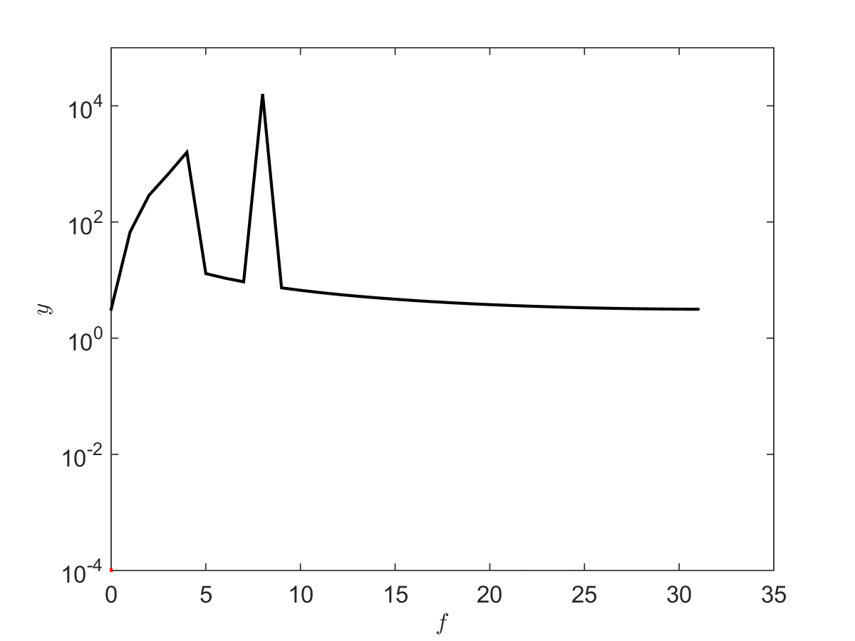
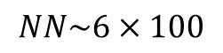
Numerical experiment III
$$NN\sim 6×100$$

Slide 11


PINN loss in frequency domain
Consider $−Δu=g$
$$∂_{θ}L\left(k\right)≈A\left(k\right)k^{2}exp\left(−\frac{\left|πk\right|}{2w_{j}}\right)E_{j}\left(θ,k\right)$$
Weighted gradients: Competition between $k^{2}$ and exp
Special case: $k=0$

Slide 12
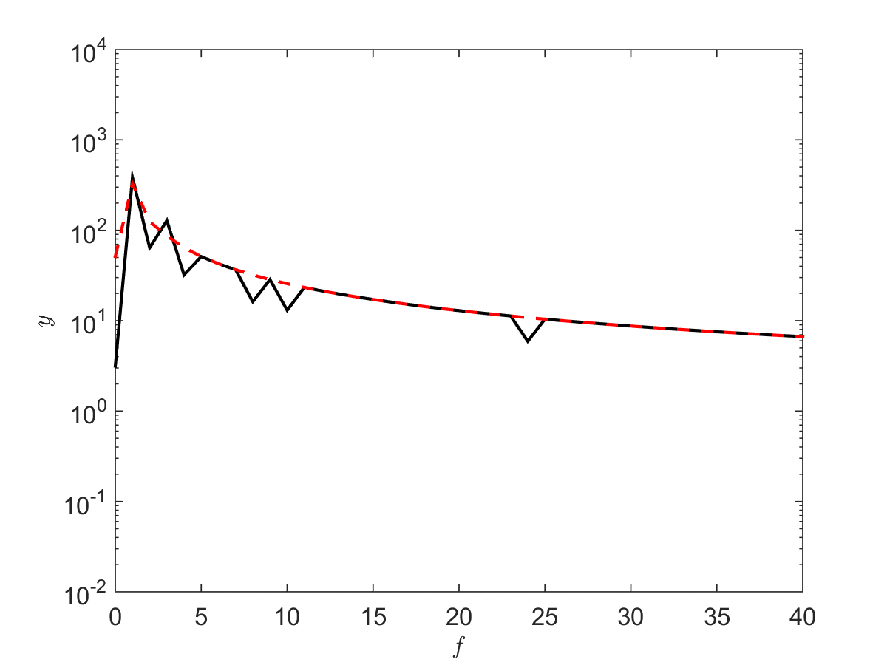
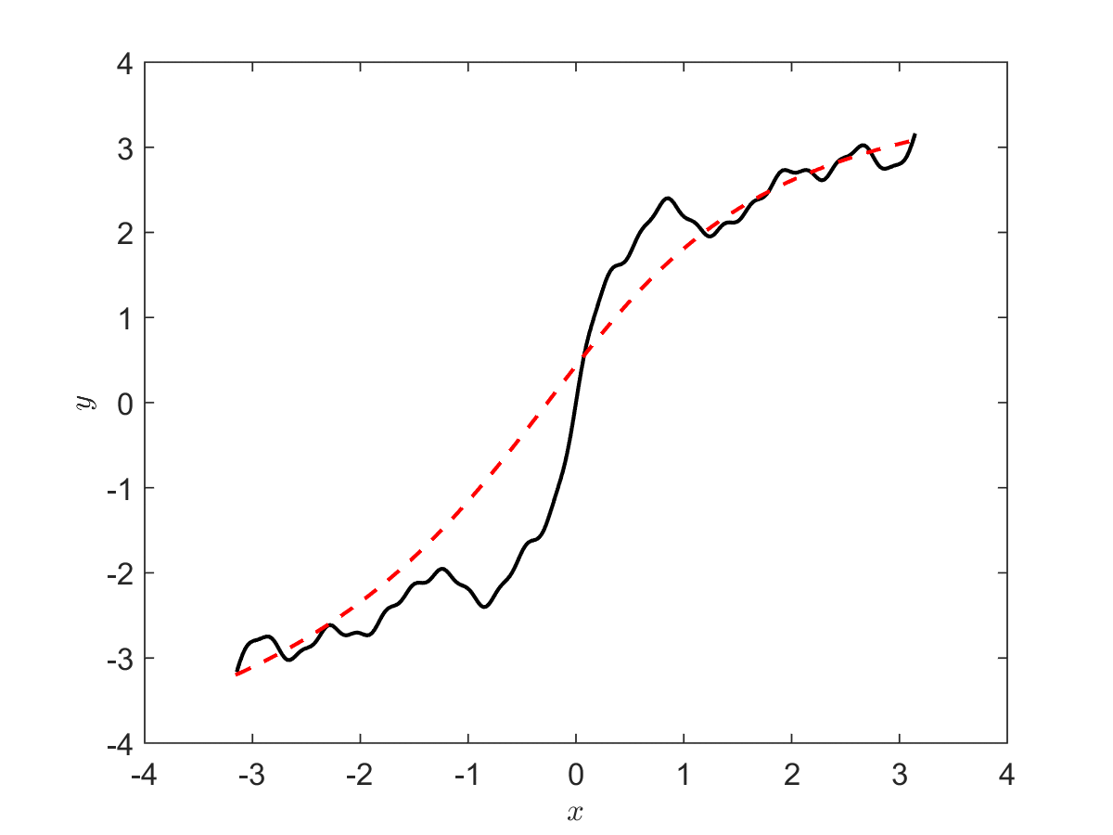
PINN loss in frequency domain
N = 256

Slide 13
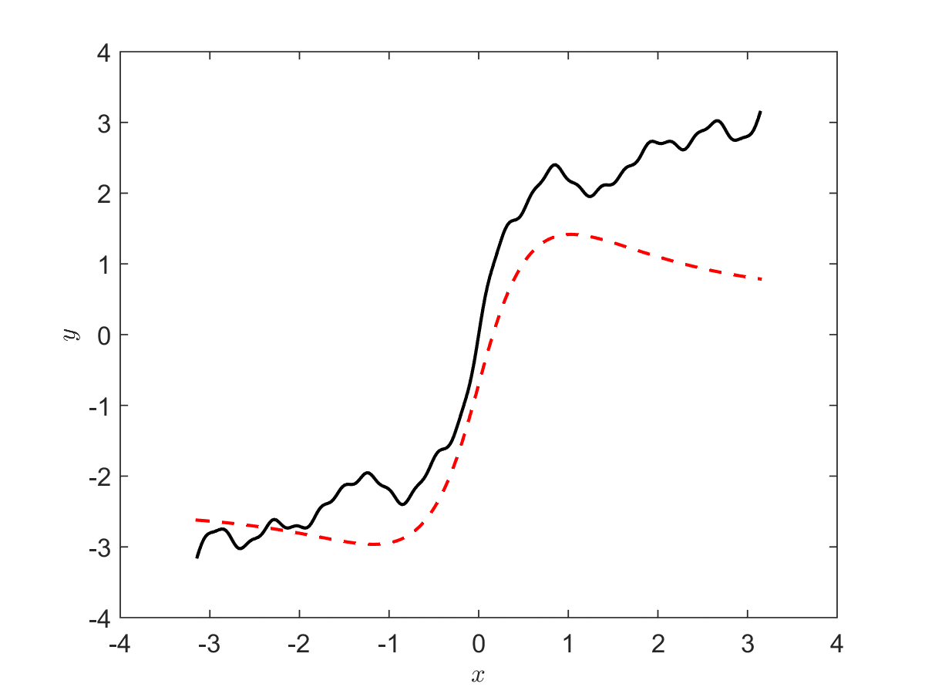
PINN loss in frequency domain
N = 256

Slide 14
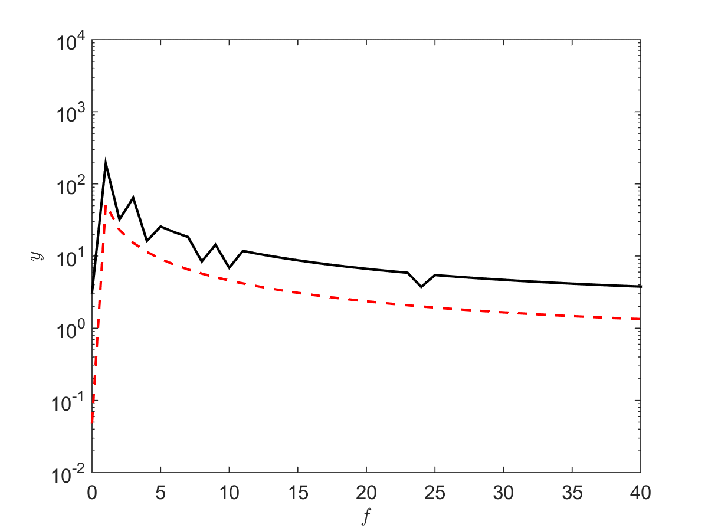
PINN loss in frequency domain
N = 256
PINNs
Function approximation

Slide 15
Contents
On spectral bias of neural networks
PINN for inverse problems

Slide 16
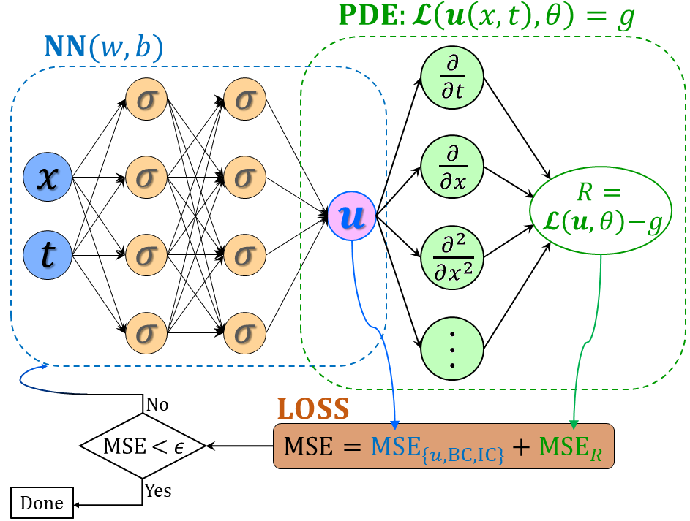
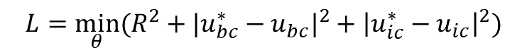

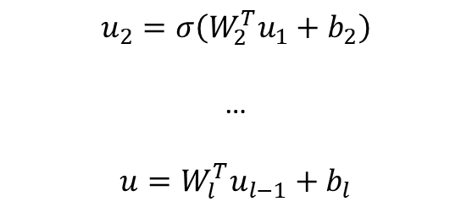

From DNNs to PINNs
$$u_{1}=σ(W_{1}^{T}X+b_{1})$$
(1)
$$u_{2}=σ\left(W_{2}^{T}u_{1}+b_{2}\right)$$
…
$$u=W_{l}^{T}u_{l−1}+b_{l}$$
(2) PDE part: Chain rule
$$∂_{t}u, ∂_{x}u, …$$
Physics-informed neural networks (PINNs)
Loss function:
Forward problem:
$$L={\min_{θ}⁡(R^{2}+|u_{bc}^{∗}−u_{bc}|}^{2}+{\left|u_{ic}^{∗}−u_{ic}\right|}^{2})$$
Inverse problem:
$$L={\min_{θ,λ}⁡(R^{2}+|u_{bc}^{∗}−u_{bc}|}^{2}+{\left|u_{ic}^{∗}−u_{ic}\right|}^{2}+{\left|u^{∗}−u\right|}^{2})$$
Raissi, et al, JCP, 2019
Meng, et al, CMAME, 2020

Slide 17
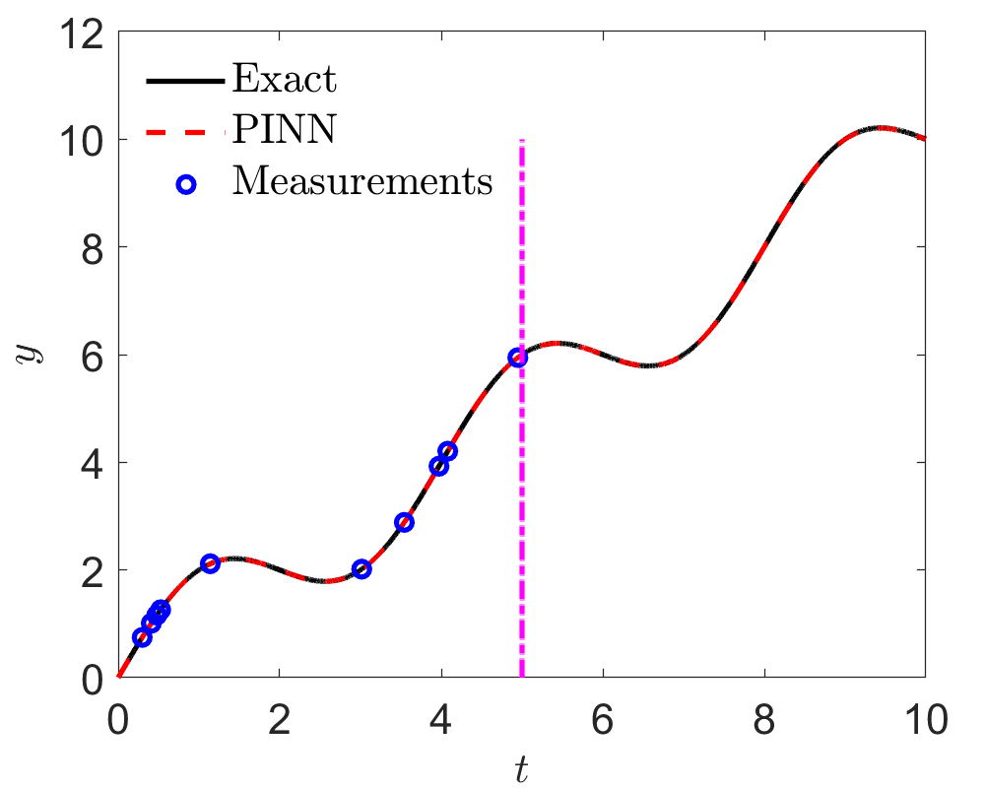
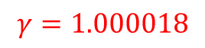
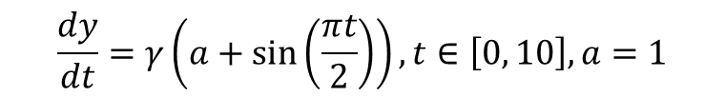

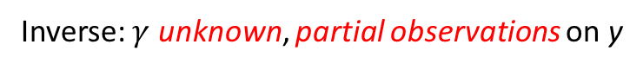
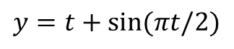
Inverse Problem
$$\frac{dy}{dt}=γ\left(a+\sin\left(\frac{πt}{2}\right)\right), t∈\left[0, 10\right], a=1$$
Inverse: $γ$ unknown, partial observations on y
Solution:
$$y=t+sin(πt/2)$$
Loss:
$$L={\left|R\right|}^{2}+{\left|y_{ic}−y_{ic}^{∗}\right|}^{2}+{\left|y−y^{∗}\right|}^{2}$$
$$γ=1.000018$$

Slide 18


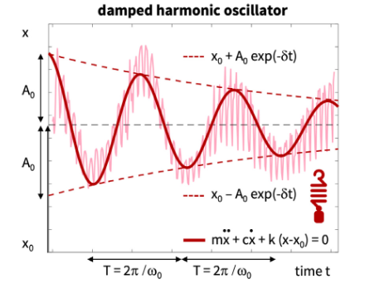
Inverse Problem: Covid-19
$$c\sim O\left(1\right), k\sim O\left(100\right), x_{0}\sim O(0.1)$$
Linka, et al., CMAME, 2022

Slide 19
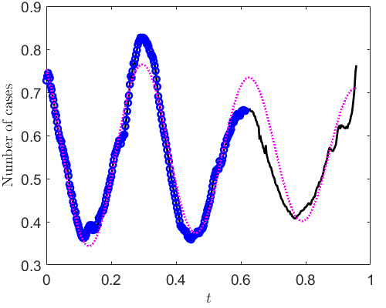
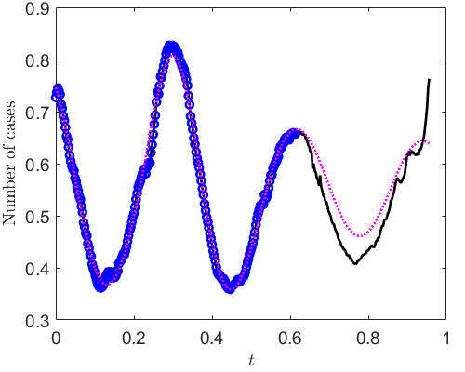
PINNs: Scaling vs no-scaling
Scale all unknowns to O(1)
scaling
PINN can fit the training data better with scaling

Slide 20
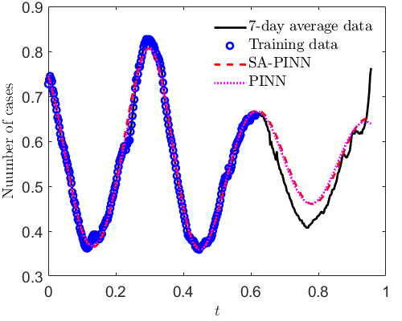
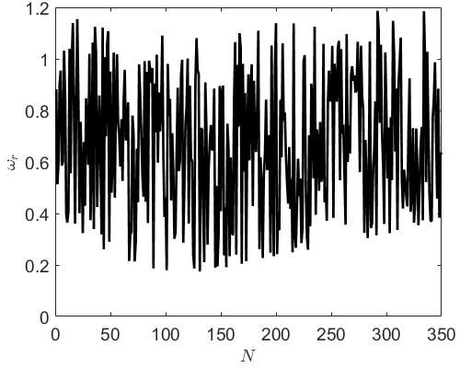
PINNs vs self-adaptive PINNs (SA-PINNs)
Comparison between PINNs and SA-PINNs
Weights for the residuals in SA-PINNs

Slide 21
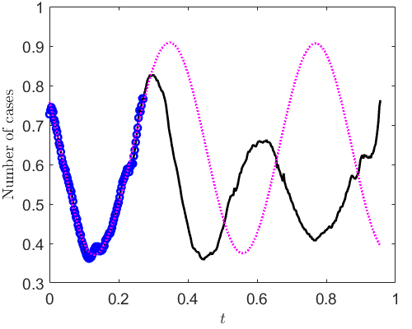
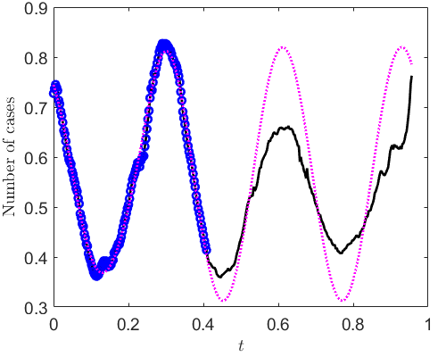
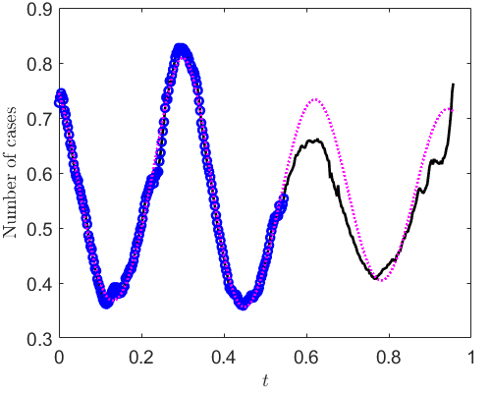
PINNs: Effect of number of training data
100 training points
150 training points
200 training points
225 training points

Slide 22
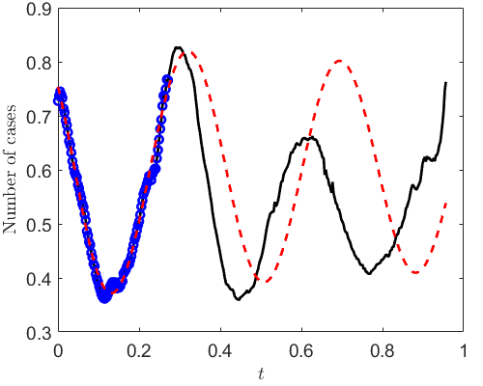

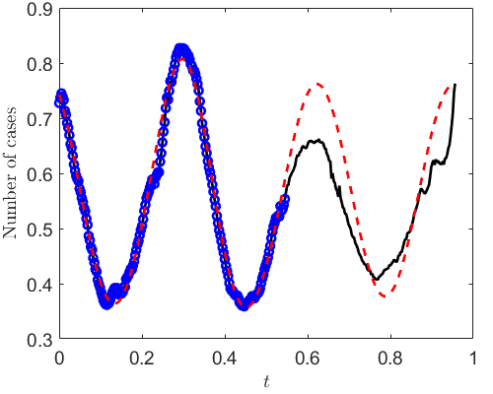
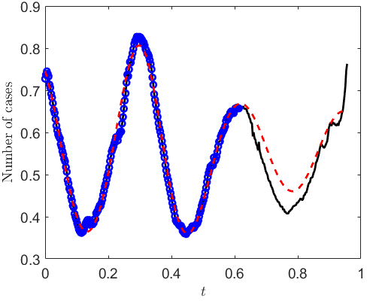
SA-PINNs: Effect of number of training data
100 training points
150 training points
200 training points
225 training points

Slide 23
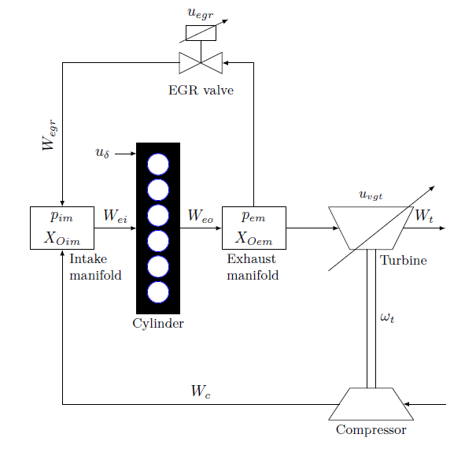
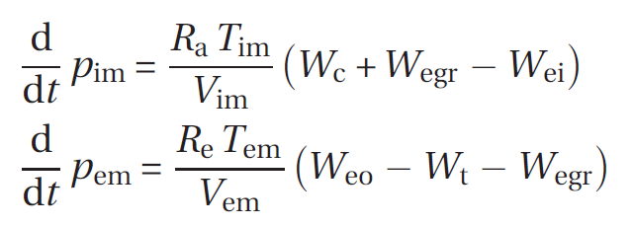
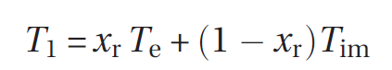
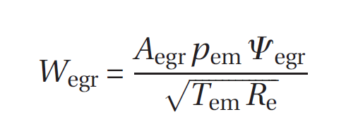

Inverse problem: diesel engines
J Wahlstrom, etc. 2011

Slide 24



Inverse problem: diesel engines
Reconstruct the dynamics
Infer unknowns in the system, e.g., $A_{egr,max}$
Given measurements on pressure
6 deep neural networks (input: t): $NN_{p}, NN_{x_{r}}, NN_{T_{1}},NN_{ω},NN_{u_{egr}},NN_u_{vgt}$
$$Loss=loss_{p}+loss_{ω_{t}}+loss_{T_{1}}+loss_{x_{r}}+loss_{u_{egr}}+loss_{u_{vgt}}+loss_{data}$$
$$Loss for equations: loss_{p}={\left|\frac{dp}{dt}−f\right|}^{2},……$$
$$Loss for data:initial conditions/measurements(invere problem)$$
J Wahlstrom, etc. 2011

Slide 25



Inverse Problem: diesel engines
PINNs
A_egrmax:
Predicted = 4.160e-4
Reference = 4.0e-4
Error = 4%

Slide 26











Inverse problem: PINN for VIV
Physical Model:
$$m\frac{∂^{2}Y}{∂t^{2}}+β\frac{∂Y}{∂t}−T\frac{∂^{2}Y}{∂z^{2}}−EI\frac{∂^{4}Y}{∂z^{4}}=f_{l}$$
$Y$: cross-flow displacement
$f_{l}$: lift
$$m\frac{∂^{2}X}{∂t^{2}}+β\frac{∂X}{∂t}−T\frac{∂^{2}X}{∂z^{2}}−EI\frac{∂^{4}X}{∂z^{4}}=f_{d}$$
$X$: in-line displacement
$f_{d}$: drag
Model Parameters
mass per
unit length
damping
coefficient
tension
flexural
rigidity
Distributed damping coefficient: parametrize with a neural network $β\left(z\right)={β }_{NN}(z)$
$$Y$$
Forward
$$X$$
Physics
Data
Current
$$ℒ^{q}u=f$$
$$u^{∗},f^{∗}$$
$$z$$
$$y$$
Inverse
$$x$$
Kharazmi et al, JFS, 2020

Slide 27











Inverse problem: PINN for VIV
[Kharazmi et al, JFS, 2020 ]
Network Parameters
sine
$$Y$$
NN parameters:
$$θ$$
Model parameters:
$$q=\{m,β,T,EI\}$$
PDE residual:
$$r_{NN}=m\frac{∂^{2}Y}{∂t^{2}}+β\frac{∂Y}{∂t}−T\frac{∂^{2}Y}{∂z^{2}}−EI\frac{∂^{4}Y}{∂z^{4}}−f_{l}$$
$$loss=\frac{1}{N_{Y}}\sum_{i=1}^{N_{Y}}{{\left|Y_{NN}\left(z_{i},t_{i};θ\right)−Y\left(z_{i},t_{i}\right)\right|}^{2}}+\frac{1}{N_{r}}\sum_{j=1}^{N_{r}}{{\left|r_{NN}\left(z_{j},t_{j};θ,q\right)\right|}^{2}}$$
Loss function:
Loss $Y$ ($z_{i}$, $t_{i}$ : Training points)
Loss PDE ($z_{j}$, $t_{j}$ : Residual points)
$Y$Displacement
$f_{l}$ Lift force

Slide 28




Inverse problem: PINN for VIV
sensor 3
sensor 2
sensor 1
sensor 3
sensor 2
The response with significant noise in the input.
$20\%$added noise to the lift force.
Mean/std is based on$30$realizations.
sensor 1

Slide 29




Super resolution
Forward:
Inverse:
Lou & Meng, et al. JCP, 2021

Slide 30





Super resolution
Micro Couette flow
Micro Cavity flow
Kn=0.1
Kn=10
Lou & Meng, et al. JCP, 2021

Slide 31






PINN for Inverse Problems: Flow Over an Espresso Cup
Tomo-BOS （层析背景纹影）实验，六个相机，可重构三维的温度场。
PINNs以温度场作为训练数据，计算出三维+时间变化的速度和压力。
background-oriented schlieren (BOS)
Temperature
velocity
pressure
Flow over an espresso cup - Cai et al. JFM, 2021

Slide 32





Inverse PDE problems
$$∂_{t}T+u ⋅∇T=α∇^{2}T$$

Slide 33



Inverse PDE problems
$$∂_{t}T+u ⋅∇T=α∇^{2}T$$
Flow over an espresso cup - Cai et al. JFM, 2021

Slide 34



PINN for discovering equations
Chen et al, Nat. Commun. 2020

Slide 35

PINN for discovering equations
Chen et al, Nat. Commun. 2020

Slide 36

Thank you for your attention!

